Slide 1
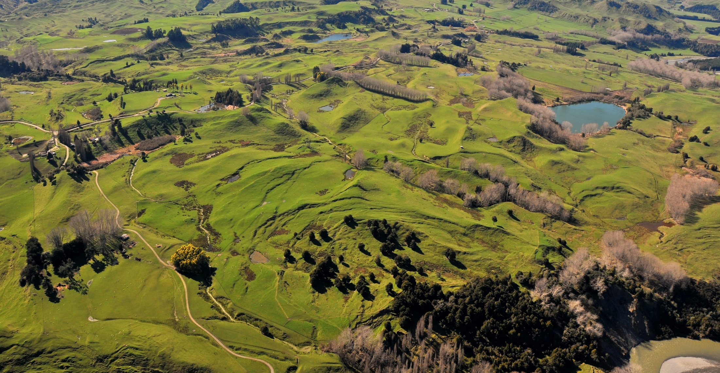
Operationalizing InSAR and Pixel Offset Time Series Methodologies for Landslide Monitoring
AGU Fall Meeting Dec 16th, 2021
f.williams1@massey.ac.nz
Notes:
Hello everyone, I’m a student at Massey University in New Zealand
static landslide inventories are common throughout the world

Slide 2
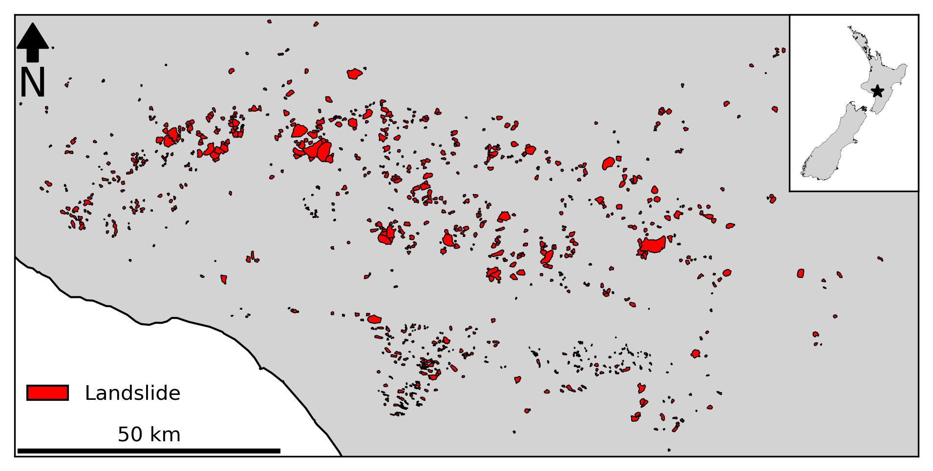
f.williams1@massey.ac.nz
Notes:
Just like many other landslide inventories many of these features are likely inactive today
Important question: which landslides are active and where are they
InSAR has long promised to solve this issue
Low coherence and small spatial signal in natural

Slide 3
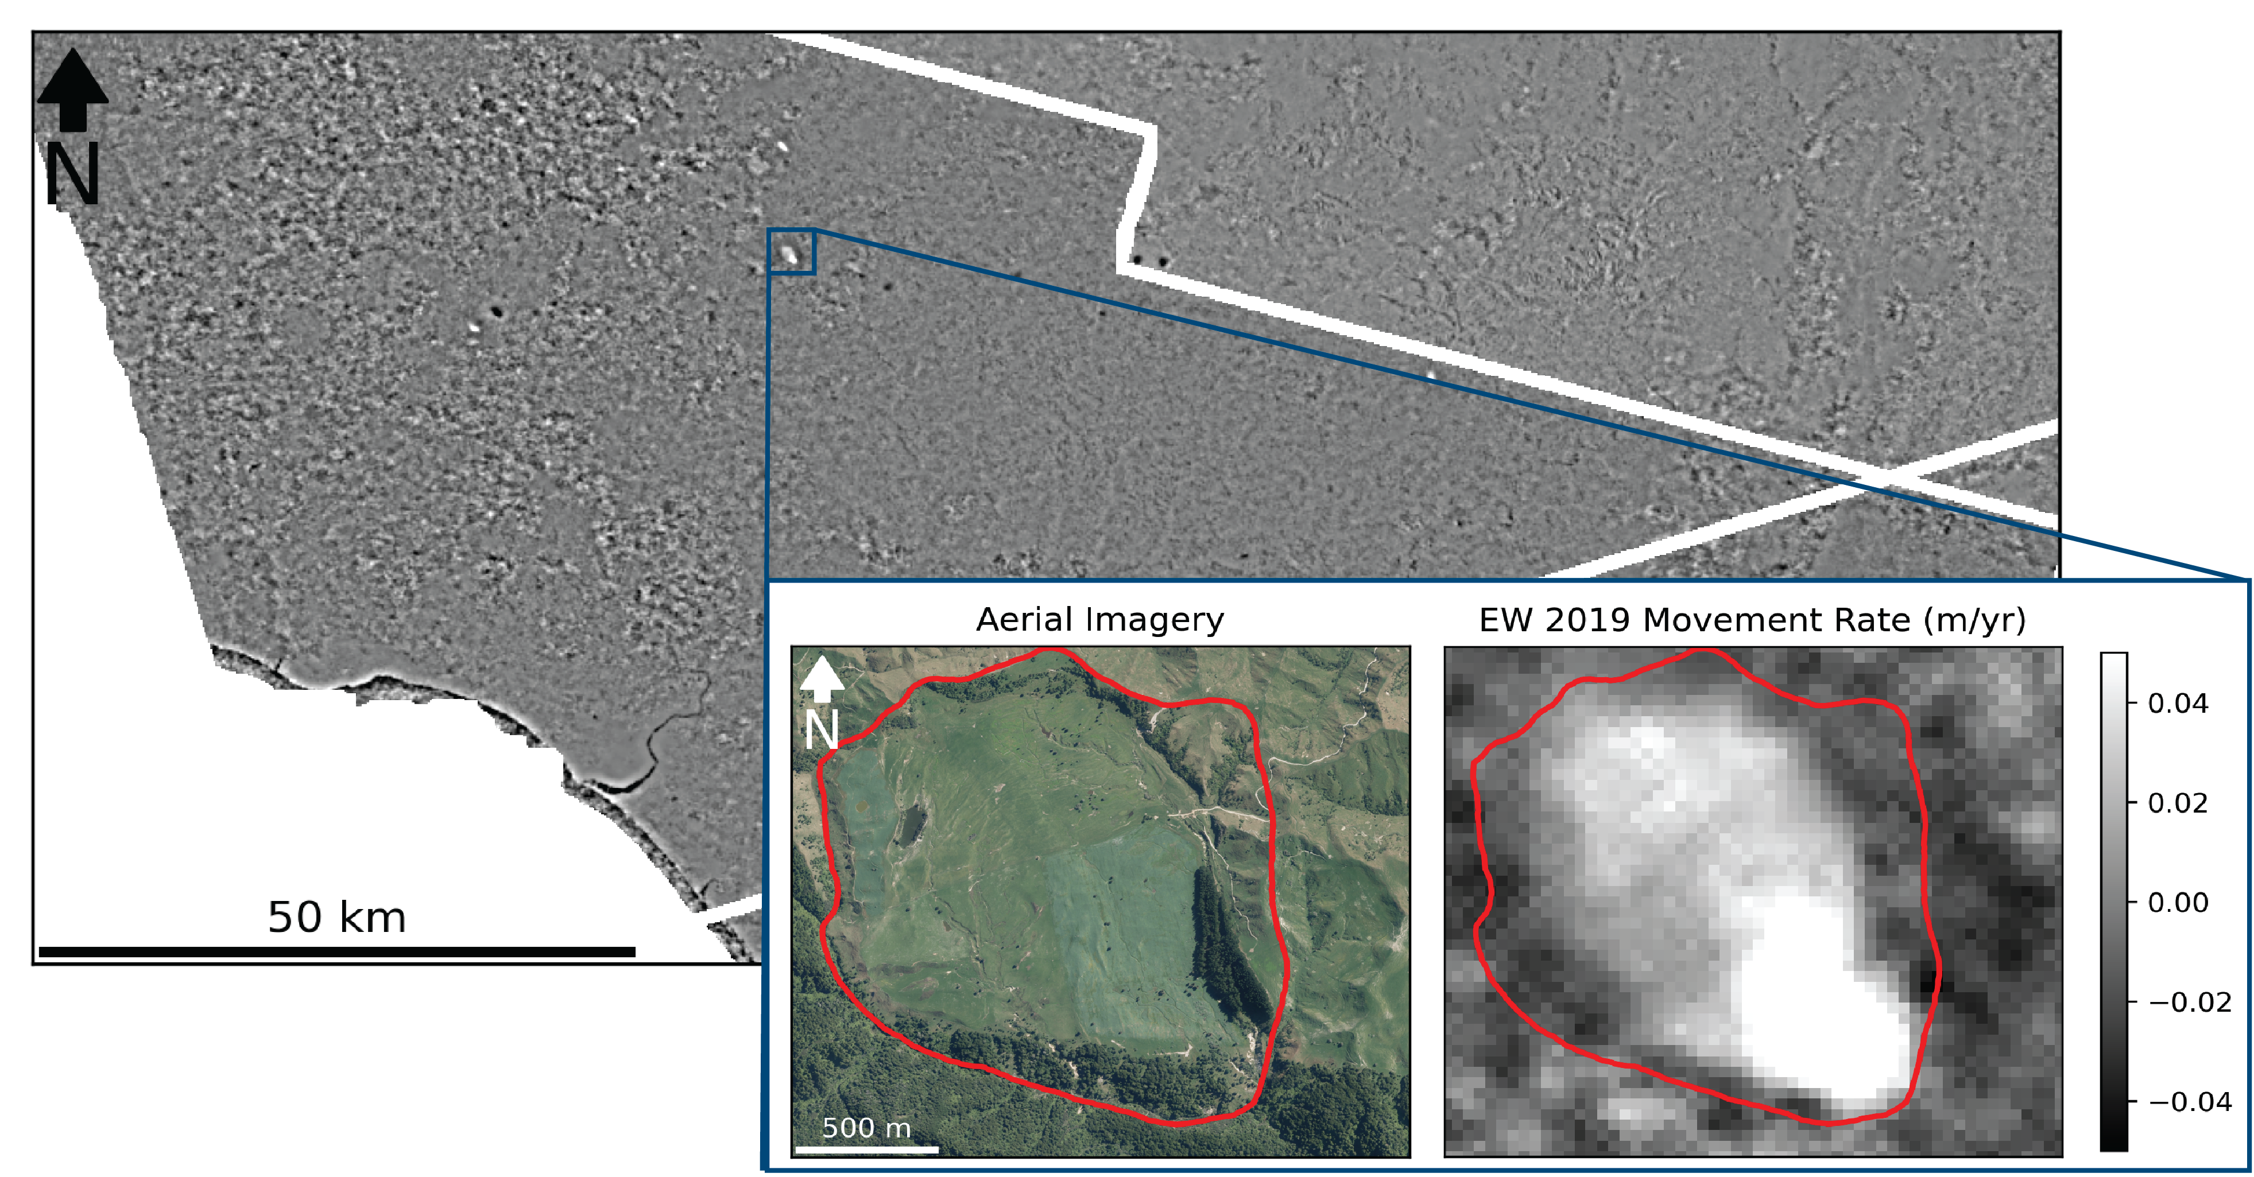
f.williams1@massey.ac.nz
Notes:
We’ve combined the latest time-series InSAR techniques and pixel-offset tracking techniques into a framework for updating landslide inventories with activity information
Better still, we utilize cloud-computing services like the Alaska satellite facility’s H Y P 3 interferogram generation service to reduce the computational expense of our analysis, and the entire workflow is written in Python jupyter notebooks with open-source tools that are publicly available on my GitHub repository.
Here we have the east to west movement rate of our entire study area in 2019 where we have also highlighted a notable active landslide

Slide 4
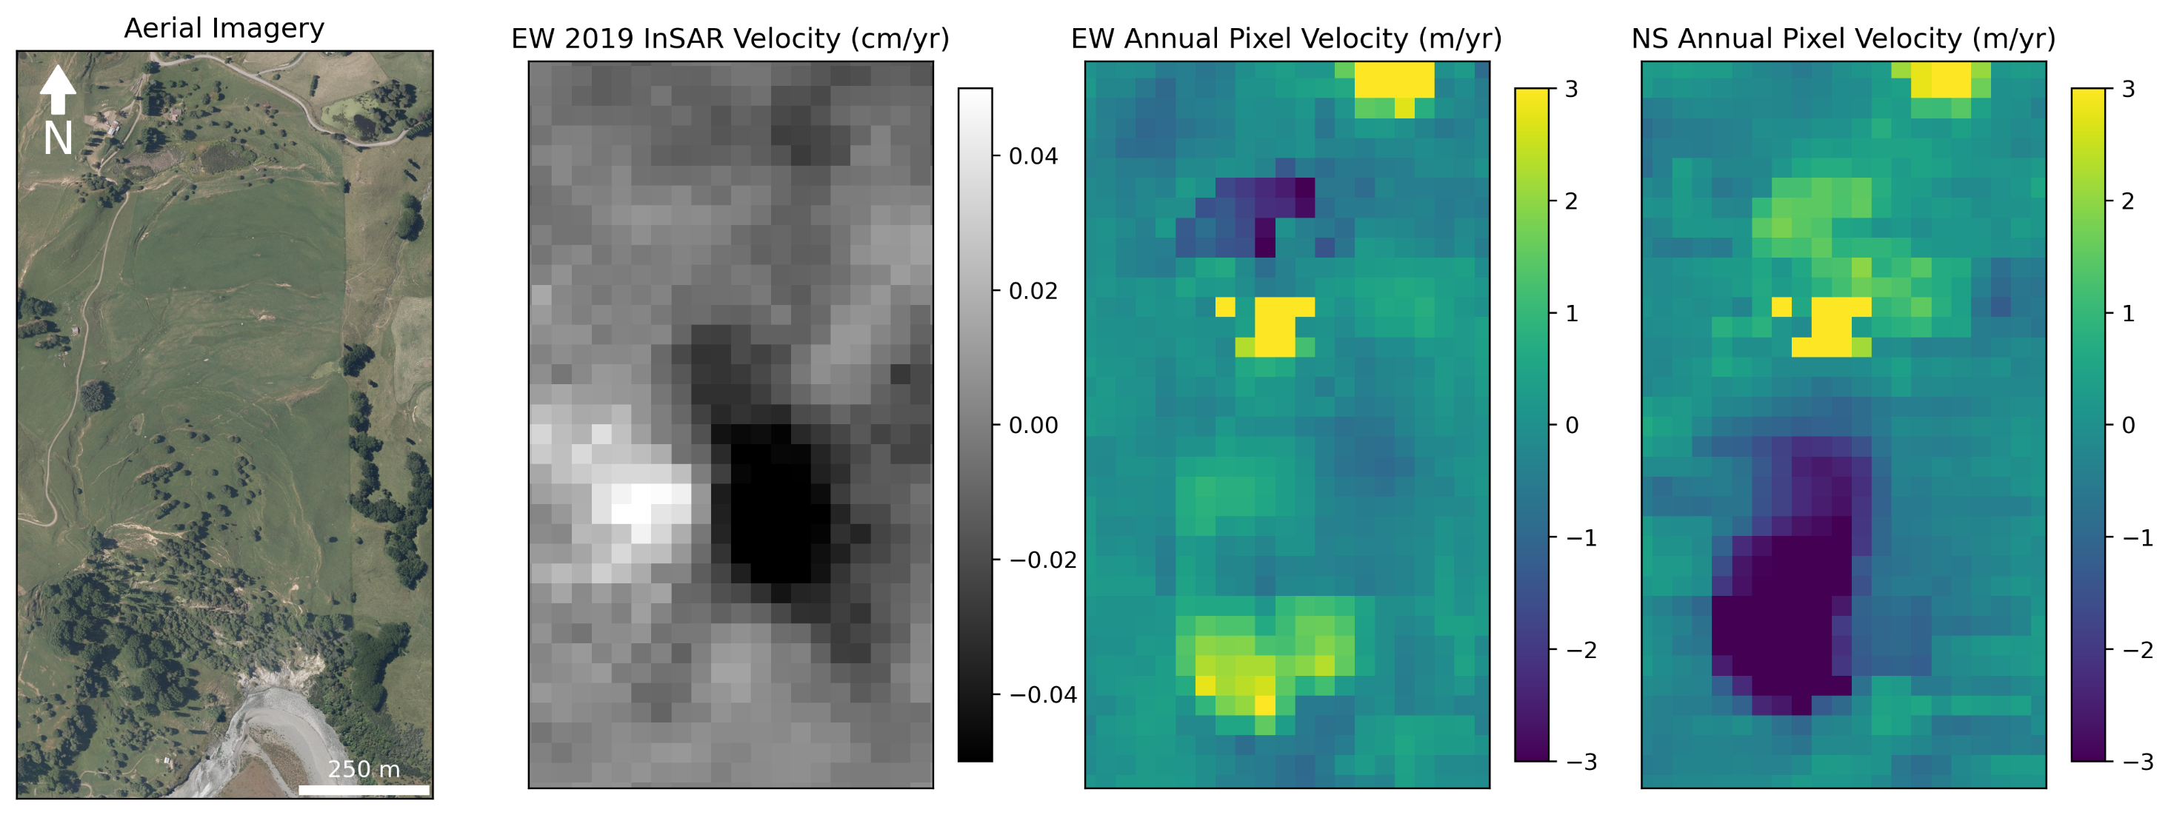
f.williams1@massey.ac.nz
Notes:
While we have seen that InSAR is capable of detecting movement in landslides that are moving at least 5 m/yr, the estimated velocity is often off by two orders of magnitude or more
Consequently, we also implement a timeseries pixel offset analysis using the new AutoRIFT python program for all active landslides
This technique does a much better job of tracking landslides whose movement rates exceed 1 m/yr
We have found that the results are very to a recent peg survey that was conducted between 2015 and 2019 at one of our landslides

Slide 5

Questions:
Email: f.williams1@massey.ac.nz
GitHub: forrestfwilliams
Twitter: @rs_forrest
Workflows:
InSAR: github.com/forrestfwilliams/hyp3_insar
Pixel Offset: github.com/forrestfwilliams/pixeloffset_mintpy
Data + Figures: github.com/forrestfwilliams/agu_2021
Thank you to Graham Hancox for the Rangitikei Landslide photography
f.williams1@massey.ac.nz
Notes:
We’ve completed the proof of concept phase of this analysis and we’re excited to extend the analysis to our full study area
Additionally we are currently partnering with Descartes Labs, a geospatial analysis company, to perform this analysis in a larger portion of New Zealand
Thank you for listening, you can contact via the conference app, email or twitter, and the workflows I presented today can be found at the github repositories listed here
Automatically identifying landslides signals in InSAR data
Estimating sediment output of landslides using pixel-offset data

